Slide 1
Procrastination & The ALU
Combating Procrastination, Binary Number Representation, The Arithmetic Logic Unit (ALU), Project 3 Overview

Slide 2
Lecture Outline
Combating Procrastination
Procrastination Reflection and Avoidance Tips
Binary Number Representations
Unsigned, Signed, and Two’s Complement
The Arithmetic Logic Unit (ALU)
Specification and ALU Function Examples
Project 3 Overview
ALU Implementation Strategy
HDL Tips and Tricks

Slide 3
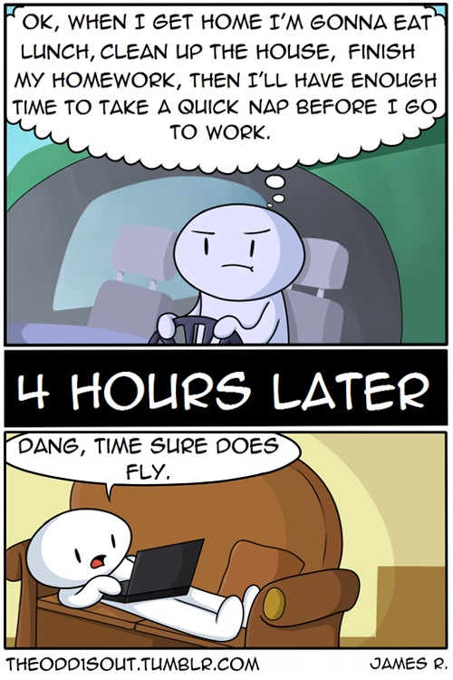
Let’s Talk Procrastination
What is procrastination?
Procrastination is the act of putting things off or choosing to do something you prefer to do (or might even need to do) instead of the actual project or chore or work you need to be doing now
Common challenge for college students, with about 80-95% of students reporting that they procrastinate (Steel, 2007)
Steel, Piers. “The nature of procrastination: a meta-analytic and theoretical review of quintessential self-regulatory failure.” Psychological Bulletin Journal 133, no. 1 (2007): 65–94. https://www.researchgate.net/publication/6598646_The_nature_of_procrastination_a_meta-analytic_and_theoretical_review_of_quintessential_self-regulatory_failure_Psychol_Bull_133_65-94

Slide 4

Combating Procrastination
Identifying why we procrastinate and the internal dialogue we have with ourselves
Create a proactive strategy to course-correct when you notice you're putting off what needs to be done

Slide 5
Grab a piece of paper!

Slide 6
Grab a piece of paper!
AVOIDANCE AREAS
When you procrastinate, what do you avoid doing?
Identify 3-5 areas

Slide 7
Where does procrastination impact you most?
PERSONAL
Eating well
Exercising / Wellness activities
Getting enough sleep
Bathing & hygiene
Health care (i.e. doctor’s visit)
Balancing bank account
Relaxation & hobbies
SCHOOL/COLLEGE
Going to class
Doing class readings
Studying for tests/exams
Doing homework/ assignments
Writing papers
Starting long-term projects
Finding a study group
Talking to an instructor or TA
Making an advising appointment
SHOPPING/HOME/ MAINTENANCE
Paying bills
Getting financial aid taken care of (i.e. FAFSA, forms, etc)
Doing laundry
Cleaning
Grocery shopping
Doing dishes
SOCIAL/RELATIONSHIPS
Talking with friends
Writing email responses
Socializing
Calling relatives
WORK/CAREER
Going to work
Applying to internships/jobs
Preparing a resume
Studying for interviews

Slide 8
Grab a piece of paper!
AVOIDANCE AREAS
PROCRASTINATION BEHAVIORS
When you procrastinate, what do you avoid doing?
How do you procrastinate?
In other words, what do you do instead of the work that needs to be done?
Identify 3-5 areas
Identify 3-5 behaviors

Slide 9
Grab a piece of paper!
AVOIDANCE AREAS
PROCRASTINATION BEHAVIORS
PLANNING FOR SUCCESS
When you procrastinate, what do you avoid doing?
How do you procrastinate?
In other words, what do you do instead of the work that needs to be done?
What can you do to avoid procrastination?
What action can you take to refocus yourself on the task you need to complete?
Identify 3-5 areas
Identify 3-5 behaviors
Identify 3-5 actions

Slide 10
Tips for Avoiding Procrastination
Prioritize the tasks that you need to complete
Plan for the tasks you need to complete
Review your to-do list and schedule of upcoming events
Eliminate distractions that pull you away from focusing on the task at hand
Isolate yourself from your phone, close distracting websites, etc.
Make productive behavior accessible and sources of procrastination harder to access

Slide 11
Lecture Outline
Combating Procrastination
Procrastination Reflection and Avoidance Tips
Binary Number Representations
Unsigned, Signed, and Two’s Complement
The Arithmetic Logic Unit (ALU)
Specification and ALU Function Examples
Project 3 Overview
ALU Implementation Strategy
HDL Tips and Tricks

Slide 12




Unsigned Binary Representation
To interpret, we multiply the value of each bit by the power of two that specific bit represents
This system is unable to represent negative numbers
Example: 0b1101 in unsigned binary
(1 × 2³) + (1 × 2²) + (0 × 2¹) + (1 × 2⁰)
= (1 × 8) + (1 × 4) + (0 × 2) + (1 × 1)
= 8 + 4 + 0 + 1
= 13
Exponent:
$$3$$
$$2$$
$$0$$
$$1$$

Slide 13
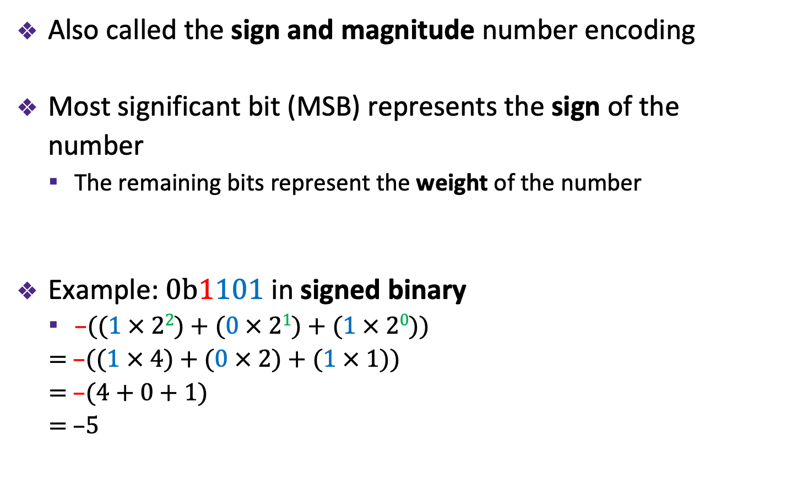




Signed Binary Representation
Also called the sign and magnitude number encoding
Most significant bit (MSB) represents the sign of the number
The remaining bits represent the weight of the number
Example: 0b1101 in signed binary
$\text{–}$((1 × 2²) + (0 × 2¹) + (1 × 2⁰))
= –((1 × 4) + (0 × 2) + (1 × 1))
= –(4 + 0 + 1)
= –$5$
Exponent:
$$3$$
$$2$$
$$0$$
$$1$$

Slide 14
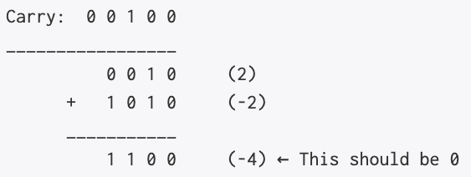
Signed Binary Representation: Limitations
Good first attempt at encoding negative numbers, but there are two main problems
First, there exists two representations of zero (a positively and negatively signed zero)
Second, adding numbers no longer works universally
Addition no longer works with negative numbers

Slide 15
Two’s Complement Binary Representation
Standard for encoding numbers in computers
Most significant bit (MSB) has a negative weight
Add the remaining bits as usual (with positive weights)
Example: 0b1101 in Two’s Complement
–(1 × 2³) + (1 × 2²) + (0 × 2¹) + (1 × 2⁰)
= –(1 × 8) + (1 × 4) + (0 × 2) + (1 × 1)
= –8 + 4 + 0 + 1
= –3
Exponent:
$$3$$
$$2$$
$$0$$
$$1$$

Slide 16
Benefits of Two’s Complement
Only one representation of zero
Represents more unique numbers compared to sign and magnitude given a fixed width binary number
Simple negation procedure: Take the bitwise complement and add one (–x = ~x + 1)
Example: To negate x = 4:
~0b0100 + 1 = 0b1011 + 0b1= 0b1100 = –8 + 4 = –4

Slide 17
Four-bit Values in Various Representations
Binary Value | Unsigned Binary | Signed Binary | Two’s Complement
0b0000 | 0 | 0 | 0
0b0001 | 1 | 1 | 1
0b0010 | 2 | 2 | 2
0b0011 | 3 | 3 | 3
0b0100 | 4 | 4 | 4
0b0101 | 5 | 5 | 5
0b0110 | 6 | 6 | 6
0b0111 | 7 | 7 | 7
0b1000 | 8 | -0 | -8
0b1001 | 9 | -1 | -7
0b1010 | 10 | -2 | -6
0b1011 | 11 | -3 | -5
0b1100 | 12 | -4 | -4
0b1101 | 13 | -5 | -3
0b1110 | 14 | -6 | -2
0b1111 | 15 | -7 | -1

Slide 18
Two’s Complement Addition
The process for adding binary in Two’s Complement is the same as that of unsigned binary
Hardware performs the exact same calculations
It doesn’t need to know the sign of the values, it performs the same calculation
The only difference is representation of sum
Example: 0b1001 + 0b0010
Unsigned interpretation:
Signed interpretation:
Two’s Complement interpretation:
carry
a | 1 | 0 | 0 | 1
b | 0 | 0 | 1 | 0
sum

Slide 19
Two’s Complement Addition
The process for adding binary in Two’s Complement is the same as that of unsigned binary
Hardware performs the exact same calculations
It doesn’t need to know the sign of the values, it performs the same calculation
The only difference is representation of sum
Example: 0b1001 + 0b0010 = 0b1011
Unsigned interpretation: 9 + 2 = 11
Signed interpretation: –1 + 2 = –3 (?)
Two’s Complement interpretation: –7 + 2 = –5
carry
a | 1 | 0 | 0 | 1
b | 0 | 0 | 1 | 0
sum | 1 | 0 | 1 | 1

Slide 20
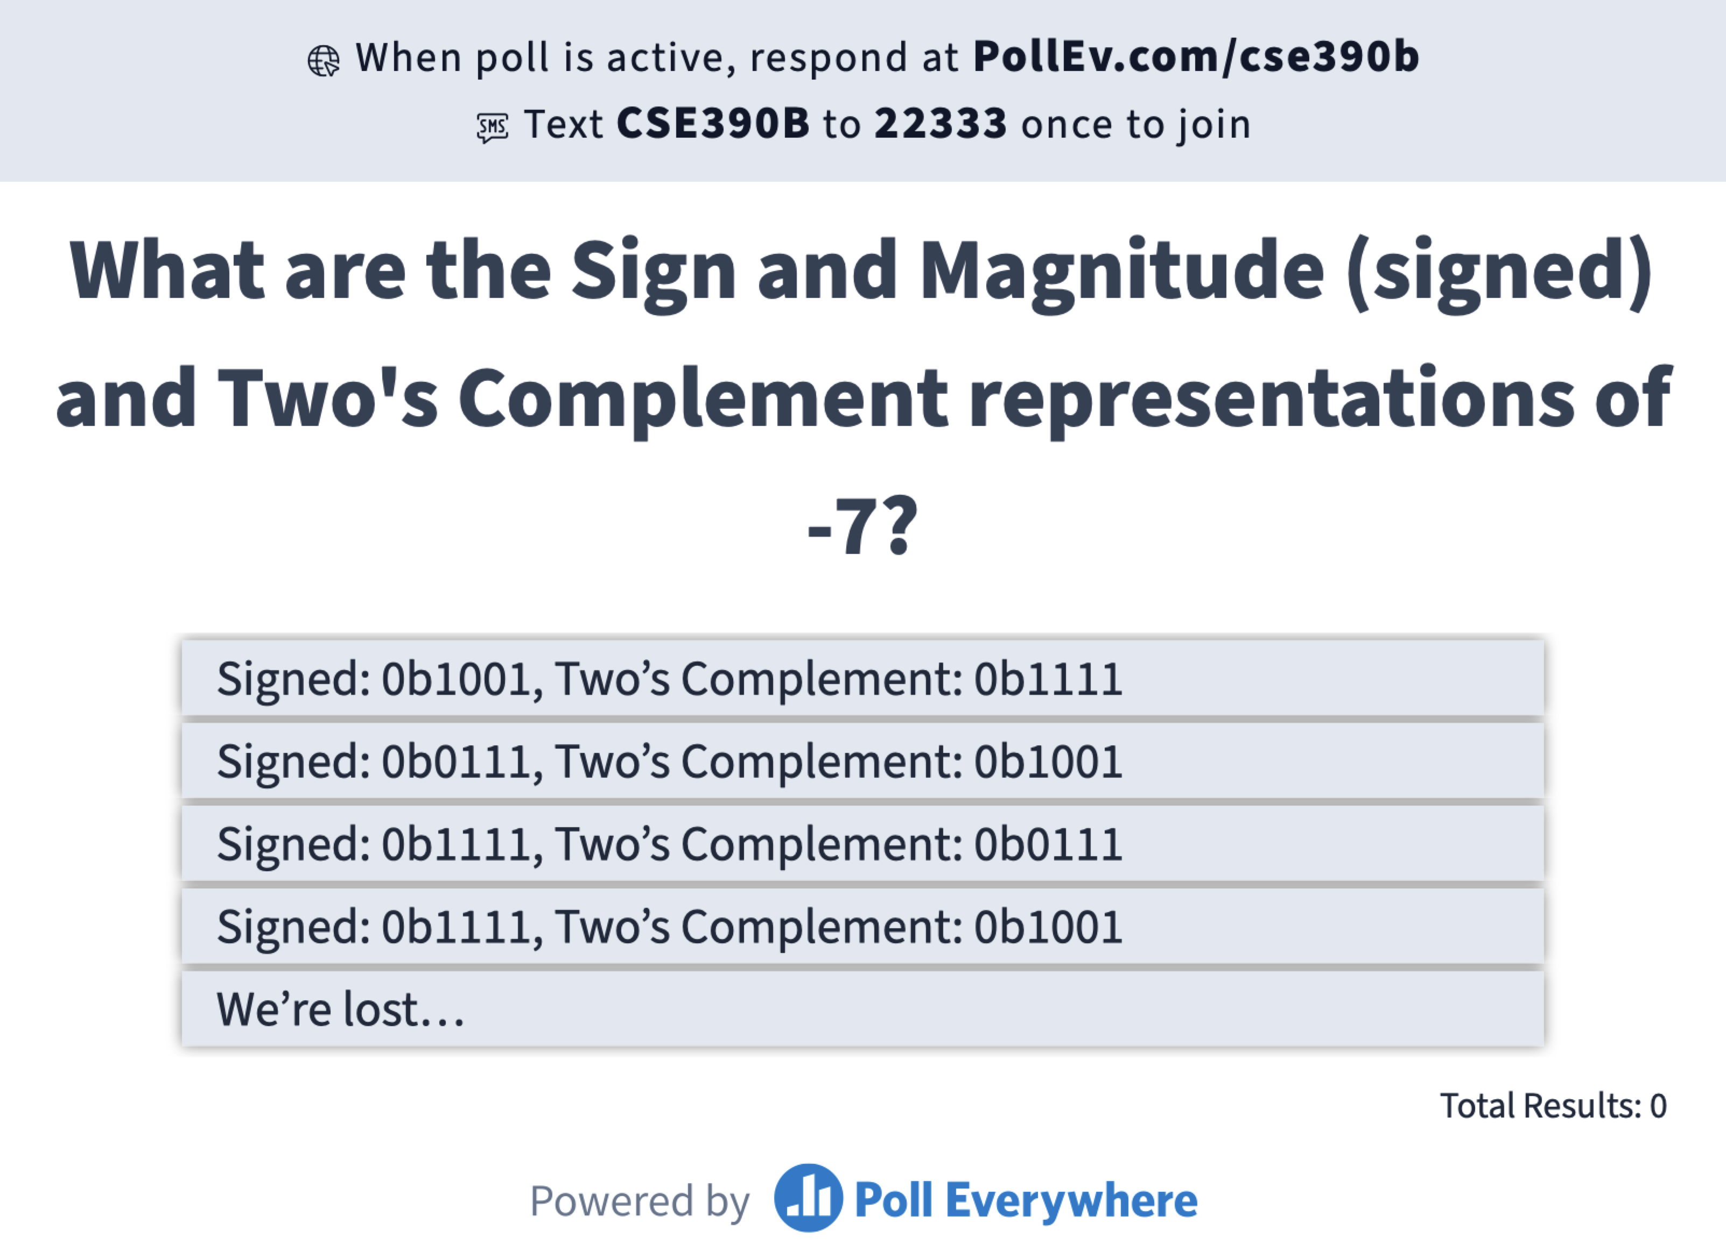
What are the Sign and Magnitude (signed) and Two’s Complement binary representations of the number -7?
Signed: 0b1001, Two’s Complement: 0b1111
Signed: 0b0111, Two’s Complement: 0b1001
Signed: 0b1111, Two’s Complement: 0b0111
Signed: 0b1111, Two’s Complement: 0b1001
We’re lost…

Slide 21
Lecture Outline
Combating Procrastination
Procrastination Reflection and Avoidance Tips
Binary Number Representations
Unsigned, Signed, and Two’s Complement
The Arithmetic Logic Unit (ALU)
Specification and ALU Function Examples
Project 3 Overview
ALU Implementation Strategy
HDL Tips and Tricks

Slide 22

The Von Neumann Architecture
COMPUTER
MEMORY
CPU
INPUT
OUTPUT
REGISTERS
CONTROL
(This picture will get more detailed as we go!)

Slide 23

The Arithmetic Logic Unit
Computes a function on two inputs to produce an output
Input Control Bits specific which function should be computed
Supports a combination of logical (And, Or) and arithmetic operations (+, –)
Indicate properties of the result with Output Control Bits (commonly called Flags)
Input Control Bits
Input A
Output
Input B
Output Control Bits
(Flags)

Slide 24
Our ALU Implementation
Inputs & Outputs
16-bit inputs x and y and output out
Interpret in Two’s Complement
Input Control Bits
Six control bits (zx, nx, zy, ny, f, no) specify which function to compute
2⁶ = 64 different possible functions to choose from (only 18 of interest)
Output Control Bits (Flags)
2 bits (zr and ng) describing the properties of the output
zx
nx
zy
ny
f
no
x
16
out
16
y
16
ng
zr

Slide 25
ALU Functions: Client’s View
 |  |  |  |  |  | out
 |  |  |  |  |  | 0
 |  |  |  |  |  | 1
 |  |  |  |  |  | -1
 |  |  |  |  |  | x
 |  |  |  |  |  | y
 |  |  |  |  |  | !x
 |  |  |  |  |  | !y
 |  |  |  |  |  | -x
 |  |  |  |  |  | -y
 |  |  |  |  |  | x+1
 |  |  |  |  |  | y+1
 |  |  |  |  |  | x-1
 |  |  |  |  |  | y-1
 |  |  |  |  |  | x+y
 |  |  |  |  |  | x-y
 |  |  |  |  |  | y-x
 |  |  |  |  |  | x&y
 |  |  |  |  |  | x|y
We support 18 different functions of interest
3 that simply give constant values (ignoring operands)
10 that change a single input, possibly with a constant
5 that perform an operation using both inputs

Slide 26
ALU Functions: Client’s View
zx | nx | zy | ny | f | no | out
1 | 0 | 1 | 0 | 1 | 0 | 0
1 | 1 | 1 | 1 | 1 | 1 | 1
1 | 1 | 1 | 0 | 1 | 0 | -1
0 | 0 | 1 | 1 | 0 | 0 | x
1 | 1 | 0 | 0 | 0 | 0 | y
0 | 0 | 1 | 1 | 0 | 1 | !x
1 | 1 | 0 | 0 | 0 | 1 | !y
0 | 0 | 1 | 1 | 1 | 1 | -x
1 | 1 | 0 | 0 | 1 | 1 | -y
0 | 1 | 1 | 1 | 1 | 1 | x+1
1 | 1 | 0 | 1 | 1 | 1 | y+1
0 | 0 | 1 | 1 | 1 | 0 | x-1
1 | 1 | 0 | 0 | 1 | 0 | y-1
0 | 0 | 0 | 0 | 1 | 0 | x+y
0 | 1 | 0 | 0 | 1 | 1 | x-y
0 | 0 | 0 | 1 | 1 | 1 | y-x
0 | 0 | 0 | 0 | 0 | 0 | x&y
0 | 1 | 0 | 1 | 0 | 1 | x|y
We support 18 different functions of interest
3 that simply give constant values (ignoring operands)
10 that change a single input, possibly with a constant
5 that perform an operation using both inputs
To select a function, set the control bits to the corresponding combination

Slide 27
ALU Functions: Implementer’s View
zx | nx | zy | ny | f | no | out
1 | 0 | 1 | 0 | 1 | 0 | 0
1 | 1 | 1 | 1 | 1 | 1 | 1
1 | 1 | 1 | 0 | 1 | 0 | -1
0 | 0 | 1 | 1 | 0 | 0 | x
1 | 1 | 0 | 0 | 0 | 0 | y
0 | 0 | 1 | 1 | 0 | 1 | !x
1 | 1 | 0 | 0 | 0 | 1 | !y
0 | 0 | 1 | 1 | 1 | 1 | -x
1 | 1 | 0 | 0 | 1 | 1 | -y
0 | 1 | 1 | 1 | 1 | 1 | x+1
1 | 1 | 0 | 1 | 1 | 1 | y+1
0 | 0 | 1 | 1 | 1 | 0 | x-1
1 | 1 | 0 | 0 | 1 | 0 | y-1
0 | 0 | 0 | 0 | 1 | 0 | x+y
0 | 1 | 0 | 0 | 1 | 1 | x-y
0 | 0 | 0 | 1 | 1 | 1 | y-x
0 | 0 | 0 | 0 | 0 | 0 | x&y
0 | 1 | 0 | 1 | 0 | 1 | x|y
These 18 functions are really a clever combination of 6 core operations:
1
PREPROCESS INPUTS
if zx==1,
set x to 0
if zy==1,
set y to 0
if nx==1,
negate x
if ny==1,
negate y
2
COMPUTE
if f==1, result is x + y
else, result is x & y
3
POSTPROCESS OUTPUT
if no==1,
negate result

Slide 28
ALU Functions: Implementer’s View
zx | nx | zy | ny | f | no | out
... |  |  |  |  |  | ...
0 | 0 | 1 | 1 | 1 | 0 | x-1
... |  |  |  |  |  | ...
Example: Compute x - 1
Given inputs x=0b0101 (5), y=0b0010 (2)

Slide 29
ALU Functions: Implementer’s View
zx | nx | zy | ny | f | no | out
... |  |  |  |  |  | ...
0 | 0 | 1 | 1 | 1 | 0 | x-1
... |  |  |  |  |  | ...
Example: Compute x - 1
Given inputs x=0b0101 (5), y=0b0010 (2)
1
PREPROCESS INPUTS
if zx==1,
set x to 0
if zy==1,
set y to 0
x=0b0101 (5)
Unchanged
y=0b0000 (0)
Zeroed
if nx==1,
negate x
if ny==1,
negate y
x=0b0101 (5)
Unchanged
y=0b1111 (-1)
Negated

Slide 30
ALU Functions: Implementer’s View
zx | nx | zy | ny | f | no | out
... |  |  |  |  |  | ...
0 | 0 | 1 | 1 | 1 | 0 | x-1
... |  |  |  |  |  | ...
Example: Compute x - 1
Given inputs x=0b0101 (5), y=0b0010 (2)
1
PREPROCESS INPUTS
if zx==1,
set x to 0
if zy==1,
set y to 0
x=0b0101 (5)
Unchanged
y=0b0000 (0)
Zeroed
if nx==1,
negate x
if ny==1,
negate y
x=0b0101 (5)
Unchanged
y=0b1111 (-1)
Negated
2
COMPUTE
if f==1, result is x + y
else, result is x & y
out=0b0100 (4)
x (5) + y (-1)

Slide 31
ALU Functions: Implementer’s View
zx | nx | zy | ny | f | no | out
... |  |  |  |  |  | ...
0 | 0 | 1 | 1 | 1 | 0 | x-1
... |  |  |  |  |  | ...
Example: Compute x - 1
Given inputs x=0b0101 (5), y=0b0010 (2)
1
PREPROCESS INPUTS
if zx==1,
set x to 0
if zy==1,
set y to 0
x=0b0101 (5)
Unchanged
y=0b0000 (0)
Zeroed
if nx==1,
negate x
if ny==1,
negate y
x=0b0101 (5)
Unchanged
y=0b1111 (-1)
Negated
2
COMPUTE
if f==1, result is x + y
else, result is x & y
out=0b0100 (4)
x (5) + y (-1)
3
POSTPROCESS OUTPUT
if no==1,
negate result
out=0b0100 (4)
Unchanged

Slide 32
ALU Output Control Bits
zr is 1 if out == 0
ng is 1 if out < 0
We’ll use these in a later project
The basis of comparison
Example: To evaluate if x == 4, compute x - 4 and check zr flag
These can be difficult to implement
Applying time management strategies, please start early on Project 3!
zx
nx
zy
ny
f
no
x
16
out
16
y
16
ng
zr

Slide 33
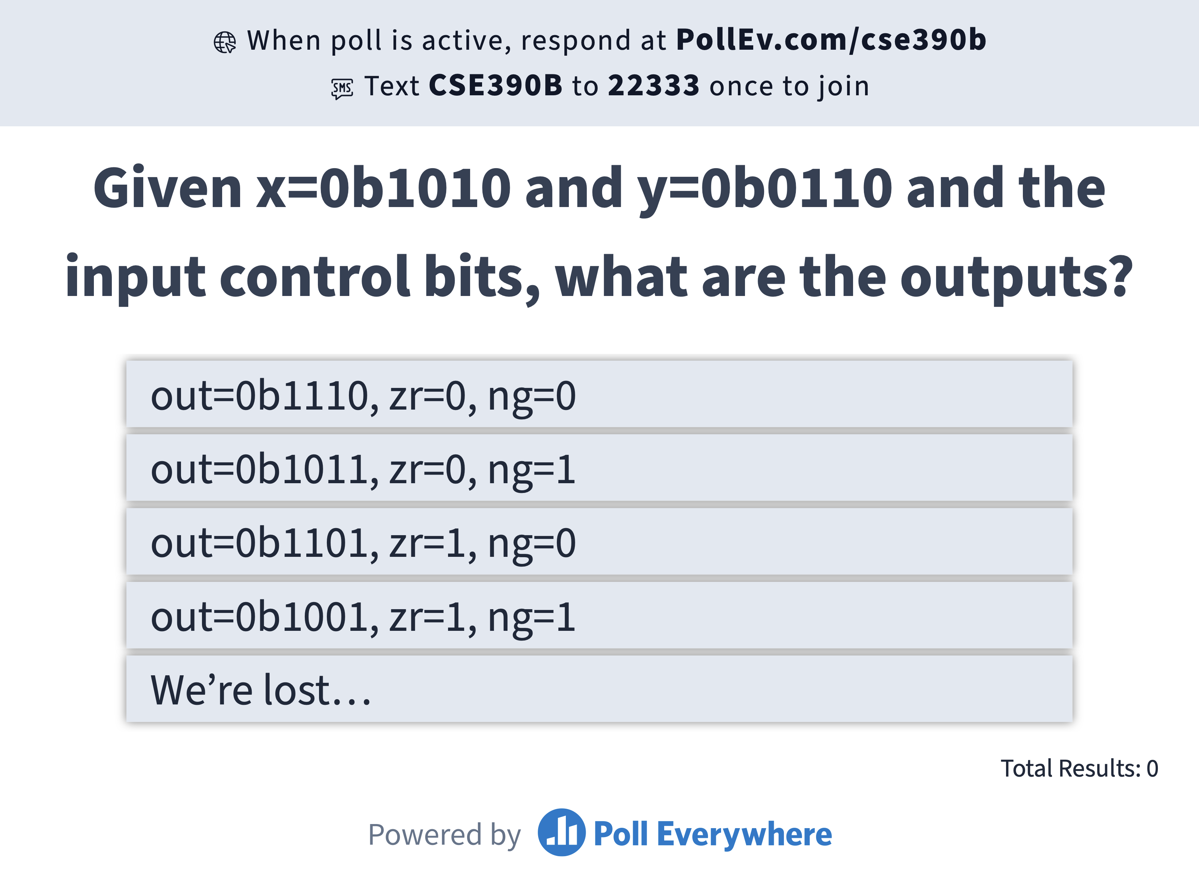
Given inputs x=0b1010 and y=0b0110 and the following input control bits, what is the resulting output and output control bits?
zx | nx | zy | ny | f | no | out
... |  |  |  |  |  | ...
0 | 1 | 1 | 1 | 1 | 1 | x+1
... |  |  |  |  |  | ...
zx | nx | zy | ny | f | no | out
... |  |  |  |  |  | ...
0 | 1 | 1 | 1 | 1 | 1 | x+1
... |  |  |  |  |  | ...
out=0b1110, zr=0, ng=0
out=0b1011, zr=0, ng=1
out=0b1101, zr=1, ng=0
out=0b1001, zr=1, ng=1
We’re lost…
IN
x[16], y[16], // 16-bit inputs
zx, // zero the x input?
nx, // negate the x input?
zy, // zero the y input?
ny, // negate the y input?
f, // compute out = x + y
if 1 or x & y (if 0)
no; // negate the out output?
OUT
out[16], // 16-bit output
zr, // 1 if (out == 0),
0 otherwise
ng; // 1 if (out < 0),
0 otherwise
IN
x[16], y[16], // 16-bit inputs
zx, // zero the x input?
nx, // negate the x input?
zy, // zero the y input?
ny, // negate the y input?
f, // compute out = x + y
if 1 or x & y (if 0)
no; // negate the out output?
OUT
out[16], // 16-bit output
zr, // 1 if (out == 0),
0 otherwise
ng; // 1 if (out < 0),
0 otherwise

Slide 34
Lecture Outline
Combating Procrastination
Procrastination Reflection and Avoidance Tips
Binary Number Representations
Unsigned, Signed, and Two’s Complement
The Arithmetic Logic Unit (ALU)
Specification and ALU Function Examples
Project 3 Overview
ALU Implementation Strategy
HDL Tips and Tricks

Slide 35
Project 3 Overview
Part I: 24-Hour Time Audit
Part II: Boolean Arithmetic
Goal: Implement the ALU, which performs the core computations we need (+ and &)
First, implement HalfAdder.hdl, FullAdder.hdl, and Add16.hdl
Then, implement the ALU in the order suggested by the specification
Chapter 2 of the textbook has more details on the adders and ALU
Part III: Project 3 Reflection

Slide 36
ALU Implementation Strategy
First, handle zeroing out and negating inputs x and y and negating the output
Ignore the f bit (only compute And) and ignore flag outputs
Test your implementation using ALU-nostat-noadd.tst
Next, implement the And and Add operations using f
How do we make decisions in hardware?
Test your implementation using ALU-nostat.tst
Lastly, implement the logic for the status flags (zr and ng)
Test your full ALU using ALU.tst

Slide 37
HDL Tips: Slicing
Sometimes want to connect only part of a multi-bit bus
HDL lets us with slicing notation
Example: ChipA has eight output pins, and we want to connect the first four to ChipB’s four inputs:
Note: We can only slice chip connections, not internal wires (e.g., w1[0..3] is not allowed)
If we need to use half an 8-bit wire, make two 4-bit wires and slice the output they’re connected to
ChipA
w1 (4)
ChipB
out (8)
in (4)
ChipA (out[0..3]=w1);
ChipB (in=w1);

Slide 38
HDL Tips: Connections
Can connect a chip output multiple times, or not at all!
Hint: In Add16.hdl, do we need to use the last carry bit?
ChipA
w1 (4)
ChipB
out (8)
in (4)
ChipA (out[0..3]=w1,
out[2..5]=w2,
out[5]=w3);
ChipB (in=w1);
ChipB (in=w2);
ChipC (in=w3);
w2 (4)
ChipB
in (4)
w3 (1)
ChipC
in (1)

Slide 39
HDL Tips: Constants
A bus of true or false contain all 1s or all 0s, respectively, and implicitly act as whatever width is needed
Example: ChipB has four inputs and ChipC has one input
ChipB (in=true) assigns four input bits a value of 1 (true)
ChipC (in=true) assigns one input bit a value of 1 (true)
ChipC (in=false) assigns one input bit a value of 0 (false)
true (4)
ChipB
Fountain of endless 1s
in (4)
ChipB (in=true);
ChipC (in=true);
ChipC (in=false);
true (1)
ChipC
in (1)
Bottomless serving of 0s
false (1)
ChipC
in (1)

Slide 40
Lecture 4 Reminders
Project 2 due tonight (1/12) at 11:59pm
Topics next week:
Metacognitive: Growth Mindset and Bloom’s Taxonomy
Technical: Sequential Logic and Building Memory
Course Staff Support
Eric has office hours in CSE2 153 today after lecture
Feel free to post your questions on the Ed discussion board too

